Slide 1
Misty robot tutorial

Slide 2
Overview
Hardware
Software
Documentation
Android/iOS app
Web interface + Python interface (RESTful)
On-robot programming
Javascript
C#

Slide 3
Hardware

Slide 4
Documentation
https://docs.mistyrobotics.com

Slide 5
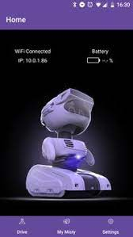
The Misty app
Needed to set-up the wifi connection of the robot
Useful for identifying IP address of the robot and other status information
Provides tele-operation tool

Slide 6
The Misty app - set-up wifi connection
Power up your Misty robot and wait for her eyes to appear fully open.
Turn on Bluetooth on your phone/tablet and make sure your device is connected to your preferred Wi-Fi network.
Launch the Misty App.
with the Misty App open on your device.
Select your Misty from the list. Note: you may need Misty's serial number by checking the label on the bottom of your robot.
Select your network from the list, and follow the prompt to enter your password.

Slide 7
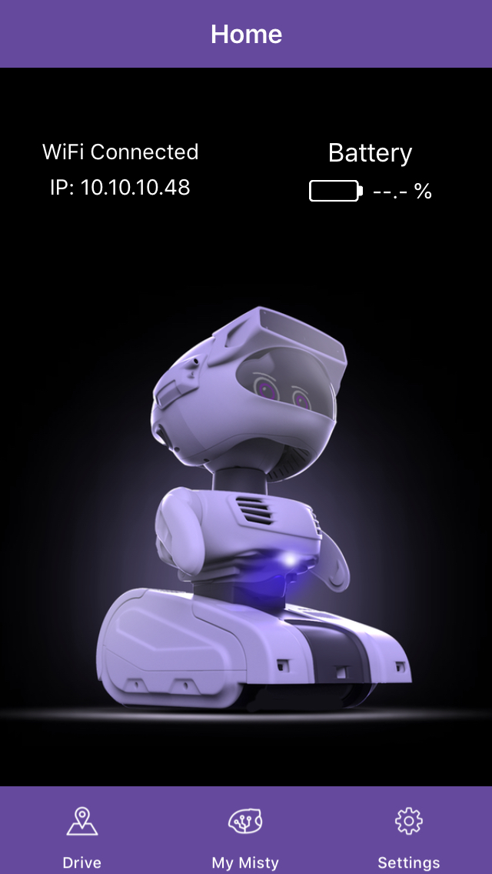
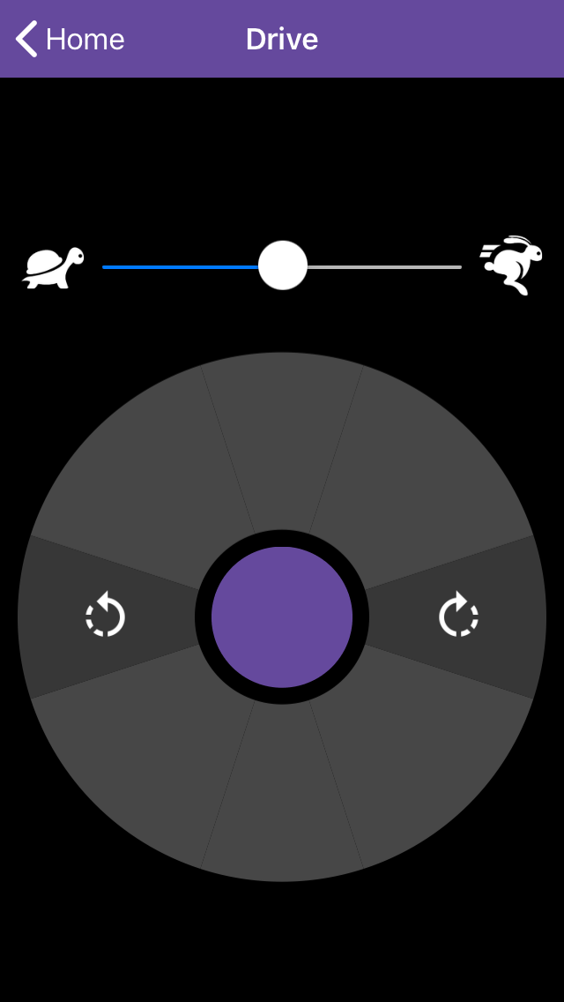
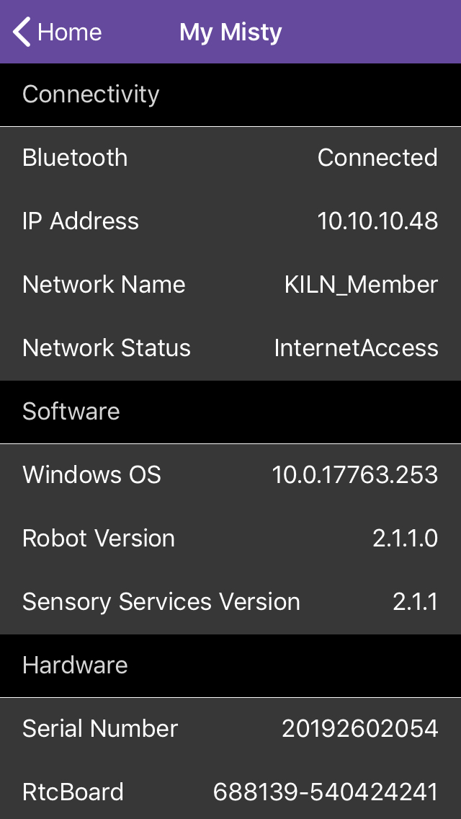
The Misty app – status info & teleoperation
Using the settings menu and the home screen you can find the robot’s IP address and the state of the battery (among others)
Using the drive menu, you can:
move forward and backward
Turn left/right
change speed

Slide 8
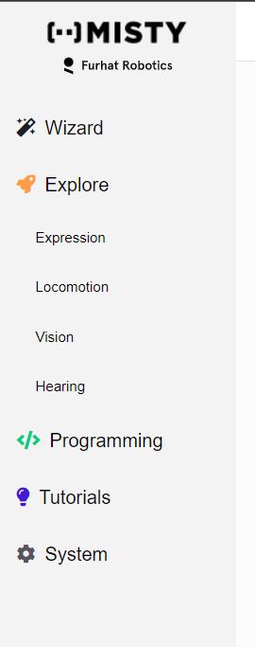
Web Interface
Open the web browser and go to Misty’s ip-address
Enter your robot's IP address in the upper-right hand corner of the page and click the Connect button
Choose Explore from the left menu

Slide 9
Web API + Python
To program misty it is easiest to use its WEB API
open up the API Explorer web page, listed under 'Programming' within Misty Studio, to access all WEB access points directly
The WEB API can also be accessed from Python. See https://github.com/MistyCommunity/Wrapper-Python for details and examples.

Slide 10
Skill programming
It is also possible to program the robot directly using javascript or C#
These so-called skills run on the robot and are needed for real-time interaction
See documentation for details
See https://github.com/MistyCommunity/Documentation for examples
It is also possible to access skills from a Python using a remote computer using the WEB API

